Slide 1
1
“TO SIMULATE THE PRIORITY
CPU SCHEDULING ALGORITHMS”

Slide 2
2
TEAM MEMBERS
Sanjay Kumar Sah(2000193):- testing connection between vs code
Shahil Kumar(2000196):- Coding in C++
Siddharth Kumar Sonu(2000206):- providing security aids to project
Sumit Kumar Giri(2000213):- Testing and fixing errors in whole project

Slide 3
Topics discussed in this presentation
3
Introduction about project
Project features
Project Description

Slide 4
Introduction about project
4
PRIORITY CPU SCHEDULING ALGORITHMS
Priority scheduling is one of the most common scheduling algorithms in batch systems. Each process is assigned a priority. Process with the highest priority is to be executed first and so on.
Processes with the same priority are executed on first come first served basis. Priority can be decided based on memory requirements, time requirements or any other resource requirement.

Slide 5
PRIORITY SCHEDULING
5
In priority scheduling, here is a priority number assigned to each process
There are two types of priority scheduling algorithm
* Preemptive
* Non-preemptive
Note:- If the priority number doesn't change itself through the Process. It is
called static priority while keeps changing itself at regular interval ,it is
dynamic priority.

Slide 6
Project features
6
• Highly Secured
• Highly Efficient
• Highly Attractive
• Provides systematic arrangement of large Datas
• Maximum Throughput Provides High End user Experience
• Not allow access to Unauthorized user
• Provides Fast output with compatibility to user
• Calculates turnaround time and waiting time in fraction of time

Slide 7

Project DescriPtion
7
PRIORITY CPU SCHEDULING ALGORITHMS
Software used:-
Visual Studio Code
Scheduling is a way of allocating threeds or processes to the CPU this task is allocating the processes to the CPU is performed by the operating system and this techaniques are very important when we have several task to make efficient utilization of the processs.

Slide 8
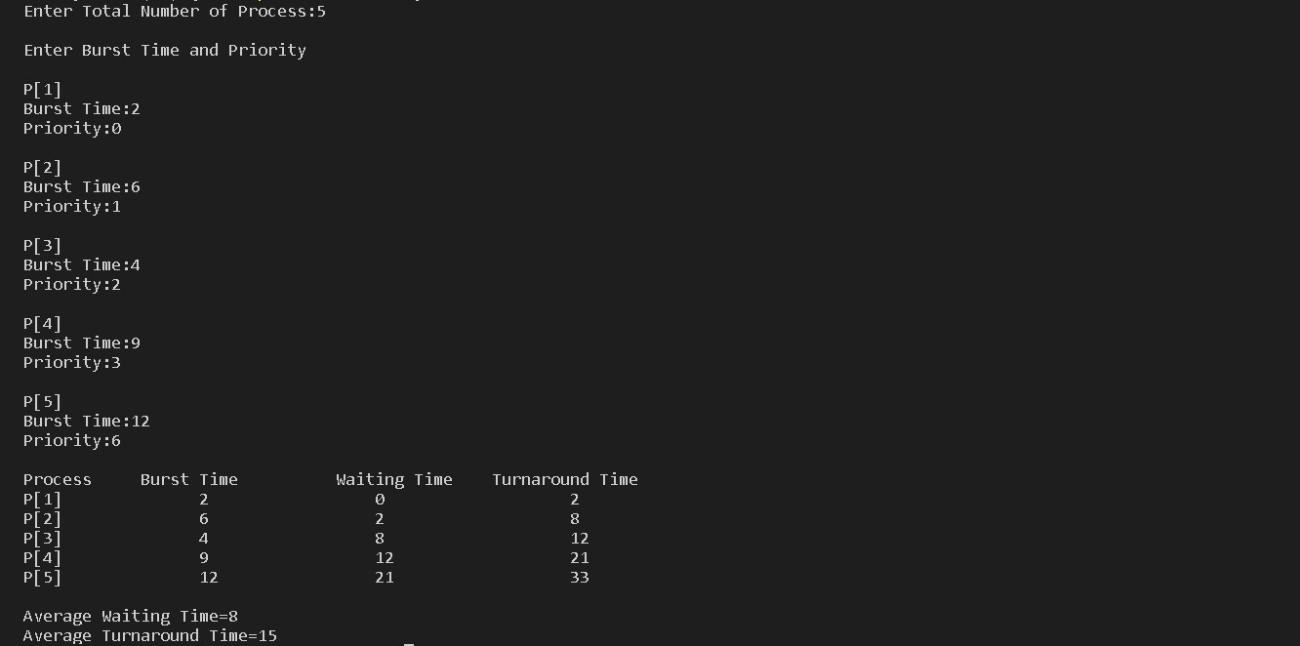
8
Code output

